Slide 1
ONLINE MOBILE & ACCESSORIES SHOP
Under the guidance of
Dr D Amuthaguka
DESIGNED BY-
M.KIRAN RAJ(9923151045)
M.MADHAN(9923151125)

Slide 2
ABSTRACT
This project outlines the creation and implementation of Online Mobile and Accessories shop, a dynamic online retail platform specializing in mobile phones and accessories using Bootstrap5.
In response to the increasing demand for convenient, high-quality tech products,Online Mobile and Accessories shop provides a curated selection of the latest smartphones, essential accessories, and innovative gadgets.
Our platform is designed with a focus on user experience, ensuring intuitive navigation, secure payment options, and prompt delivery services.

Slide 3




MODULES
User Profile
Seller
Cart
Customer Support
Offer zone
Mobile
Accessories

Slide 4
CONCLUSION
In conclusion, the development of Online Mobile represents a comprehensive approach to creating an online platform tailored to meet the growing demand for mobile phones and accessories. Through a combination of user-friendly design, diverse product offerings, and efficient order management, the platform is well-positioned to deliver a superior shopping experience.

Slide 5
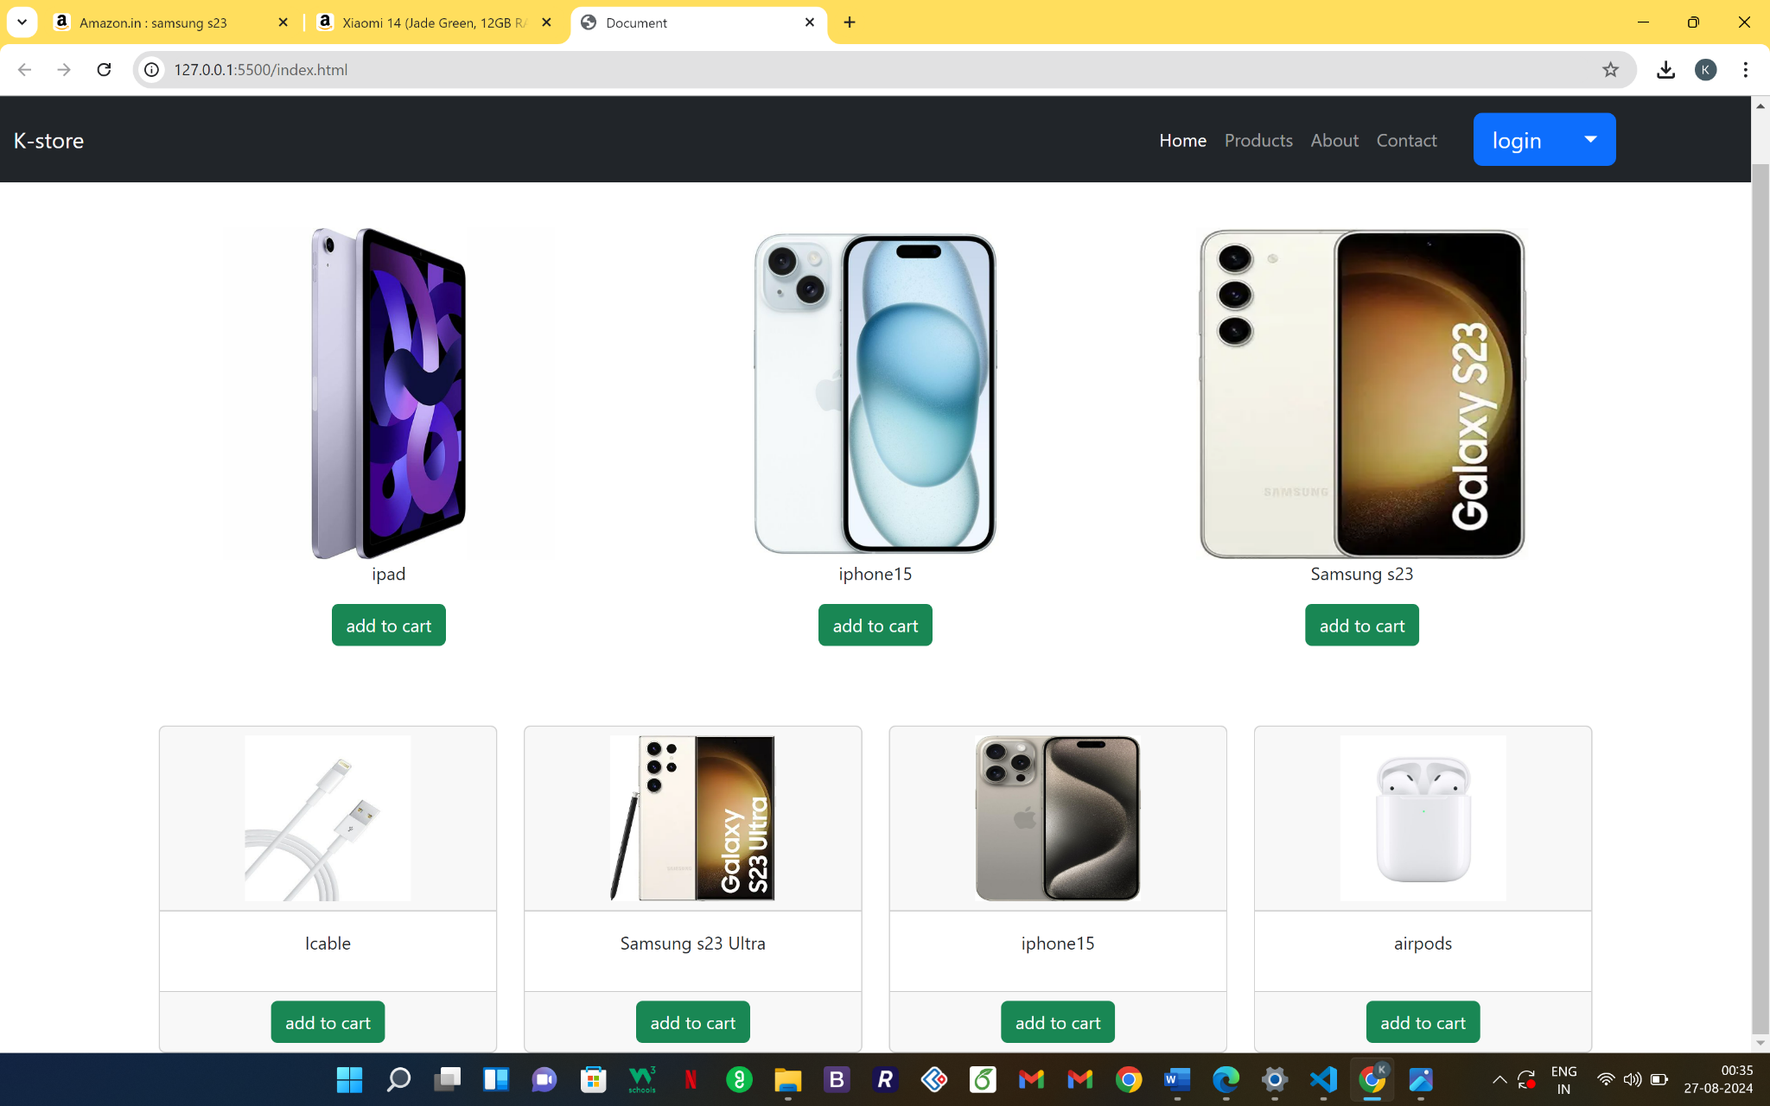
SAMPLE SCREENSHOT

Slide 6
THANK YOU

